Slide 1

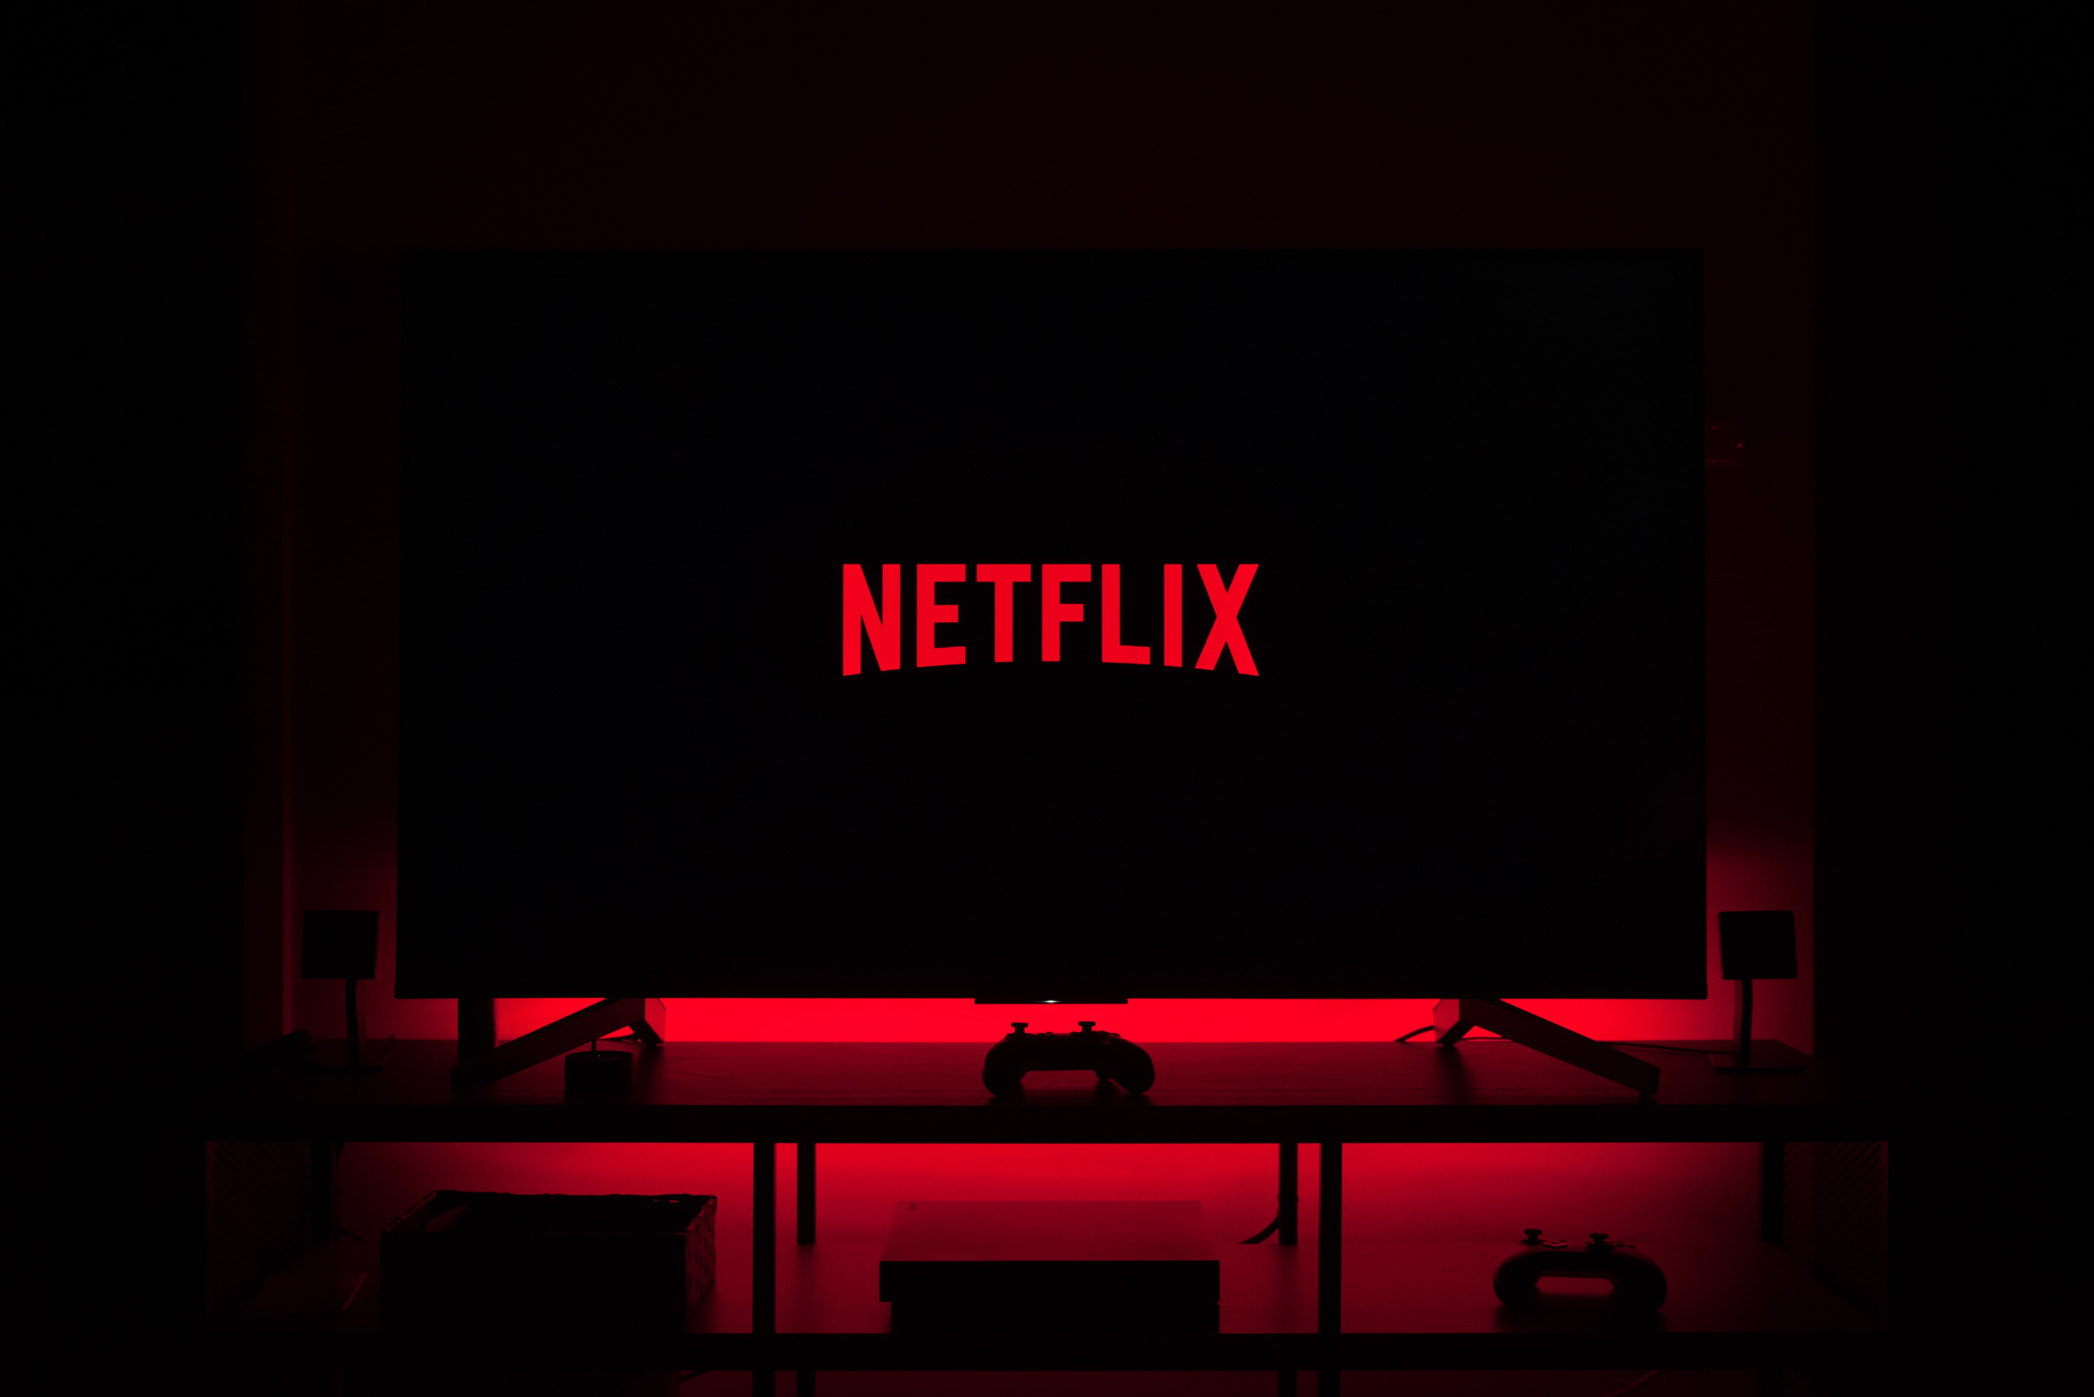
REPORT ON USE OF ML BY
Presented By:- Ayush Sharma (2115800007)
Sachin Kumar (2115800022)
Tanish Lamba (2115800025)
Abhinav Sharma (2115800001)

Slide 2
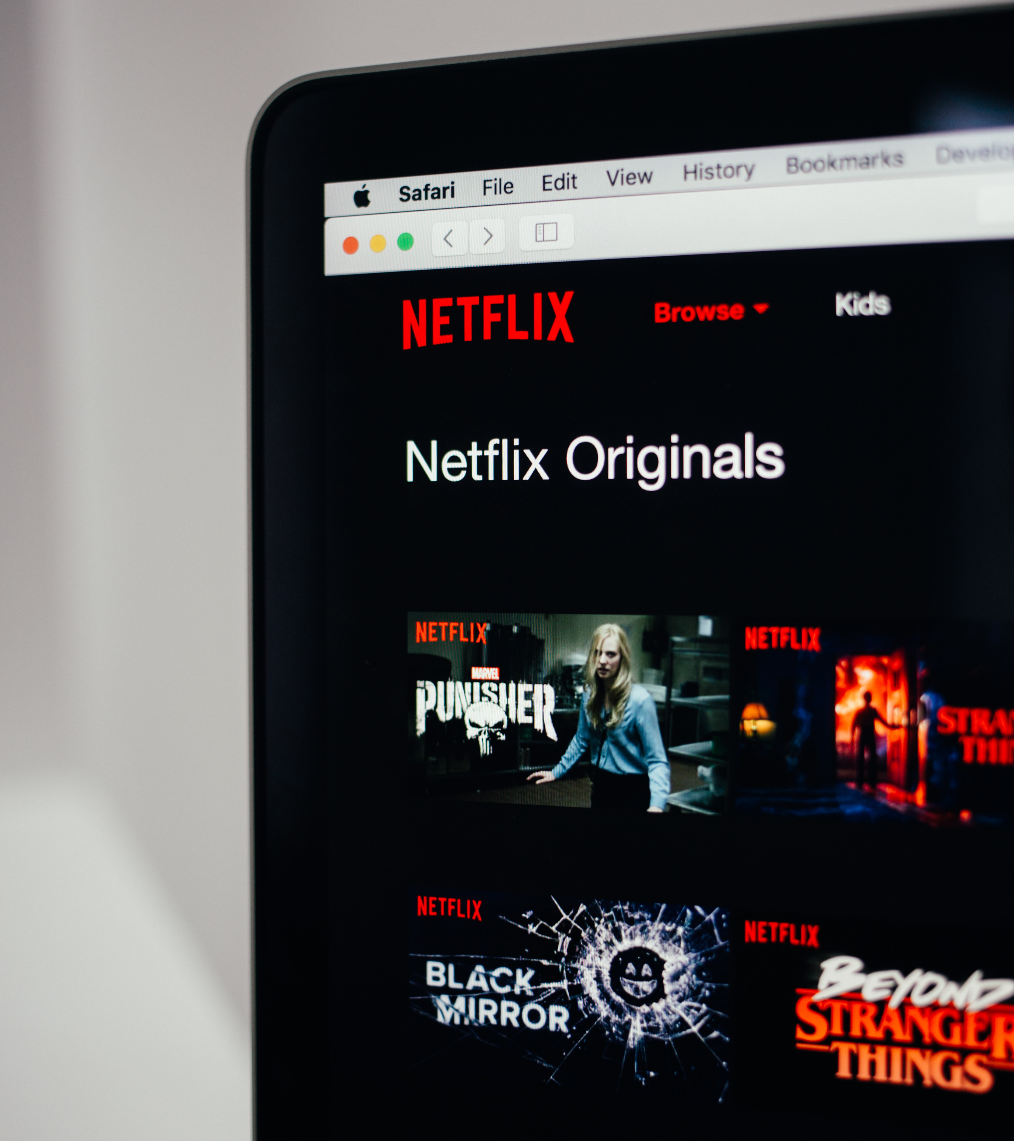
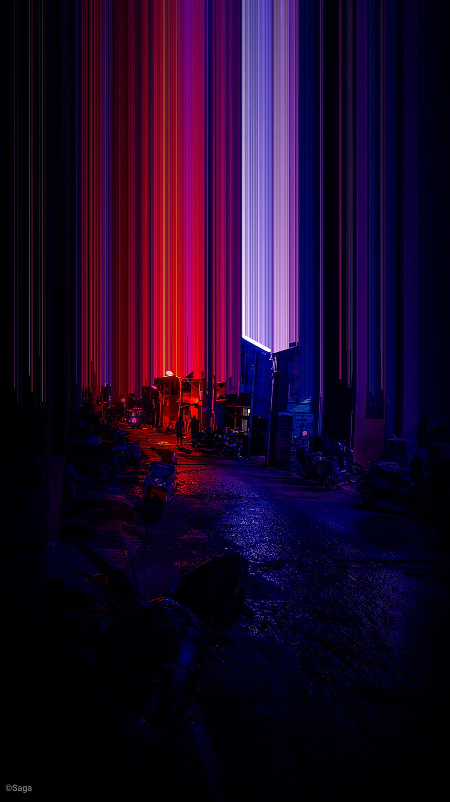
CONTENT
Introduction​
Uses of ML In NETFLIX
Benefits of ML for NETFLIX
Future of ML for NETFLIX
Conclusion

Slide 3
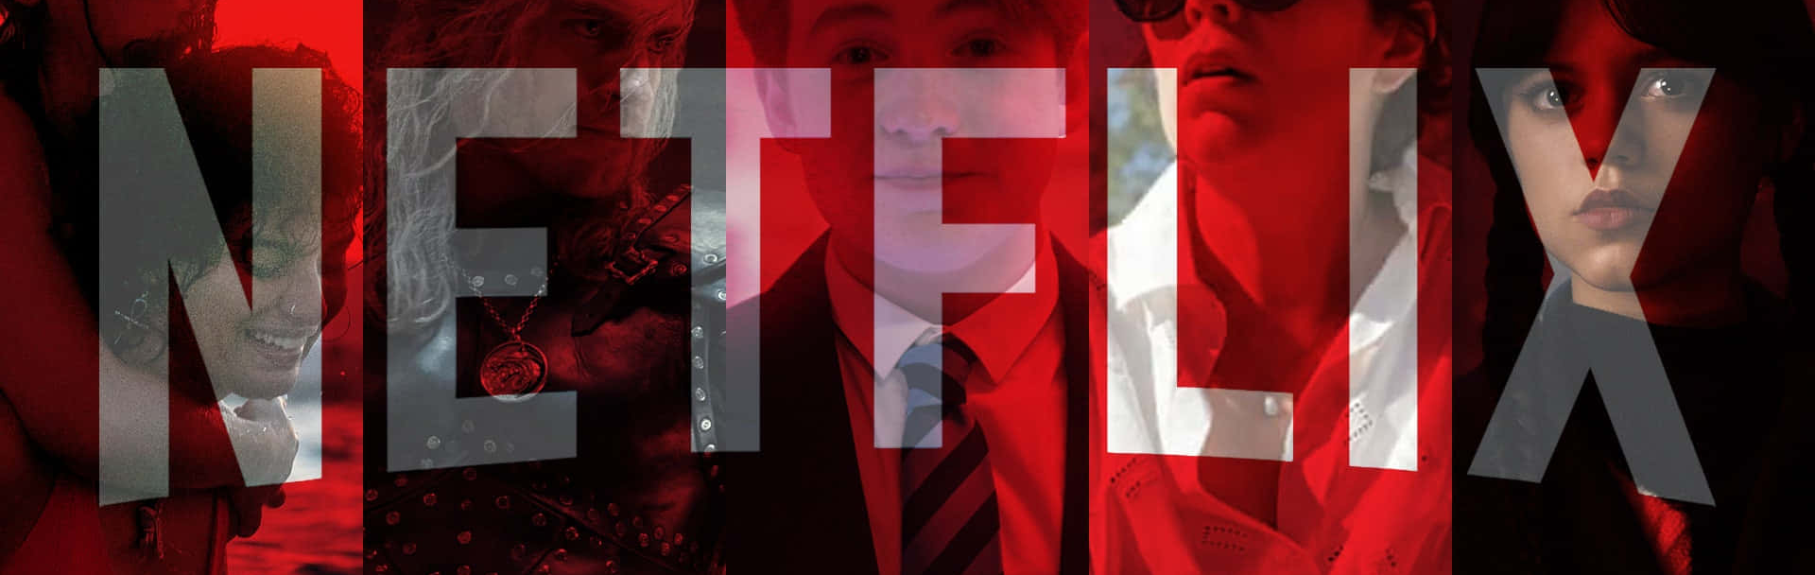
NETFLIX
Netflix, media-streaming and video-rental company founded in 1997 by American entrepreneurs Reed Hastings and Marc Randolph. It is also involved in the creation of original programming. Corporate headquarters are in Los Gatos, California.

Slide 4


In 1999 Netflix began offering an online subscription service through the Internet. Subscribers chose movie and television titles from Netflix’s Web site; the shows were then mailed to customers in the form of DVDs, along with prepaid return envelopes, from one of more than 100 distribution centres. Although customers typically rented for a flat monthly fee as many movies per month as they wished, the number of DVDs in their possession at any one time was limited according to their subscription plans. Netflix had tens of thousands of movie titles in its catalog.
In 2006 Netflix launched the $1 million Netflix Prize contest to see if anyone could improve by 10 percent its recommendation system, an algorithm for predicting an individual’s movie preferences based on previous rental data. Three years later the prize was awarded to BellKor’s Pragmatic Chaos, a team made up of seven mathematicians, computer scientists, and engineers from the United States, Canada, Austria, and Israel.

Slide 5
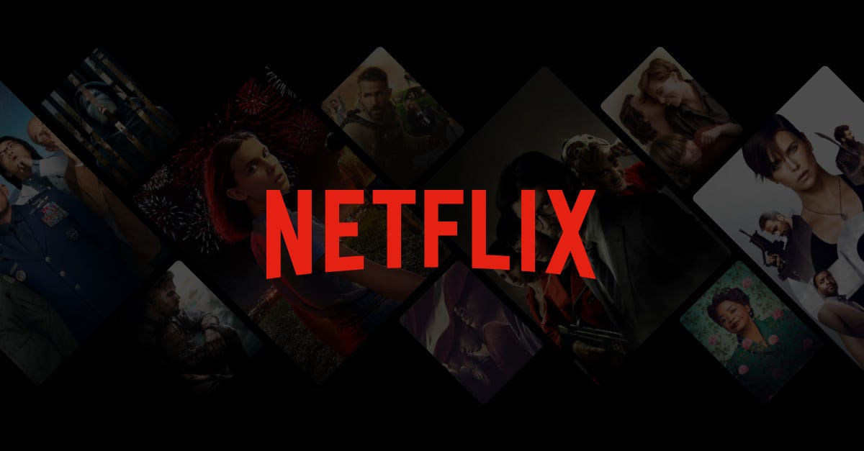
USES OF ML IN
Content Recommendation
Auto Generated Thumbnails
Streaming Quality
Location For Shooting
Content Quality
Other Uses

Slide 6
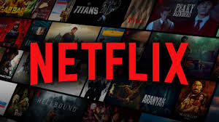
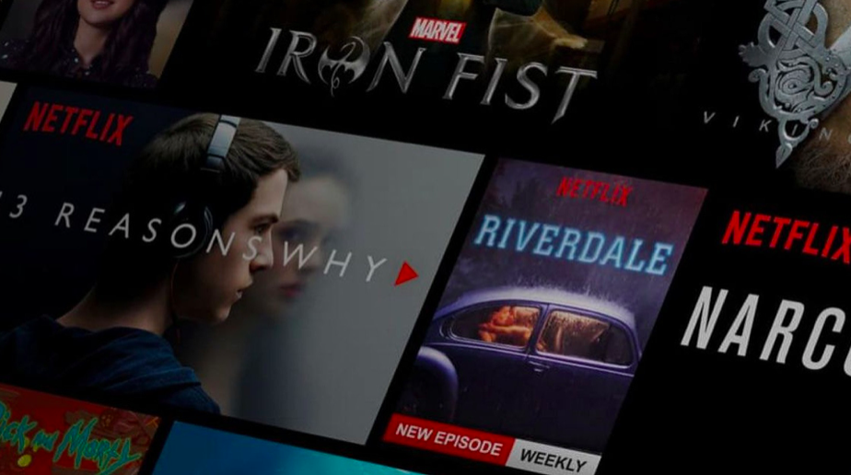
CONTENT RECOMMENDATION
What Algorithm Does Netflix Use for Recommendation?
Netflix is an extremely successful streaming platform. The service reaches over 139 million paid subscribers across 190 countries. They are the world’s leading streaming service and the most valued, but there is a secret behind the wealth of achievement. Netflix has an incredibly intelligent recommendation algorithm. In fact, they have a system built for the streaming platform. It’s called the Netflix Recommendation Algorithm, NRE for short. This software is a key player in Netflix’s success.
The NRE is composed of multiple algorithms that filter content based on a user’s profile. The system filters over 3,000+ titles using 1,300 recommendation clusters all based on an individual user’s preferences. It is robust and it pays off considering that 80% of Netflix viewer activity is a direct result of personal recommendations. Plus, it saves Netflix billions of dollars a year by keeping subscribers from canceling.

Slide 7
CONTENT RECOMMENDATION
Why Does Netflix Use A Recommendation Algorithm?
According to Netflix, the company estimates that they have about 90 seconds to grab a consumer’s attention. In order to do this, they need to make sure they are promoting videos with a strong likelihood of being viewed. That 80% success rate keeps subscribers happy. Essentially, Netflix believes it could lose $1 billion or more every year from subscribers quitting its service if it didn’t use the Netflix Recommendation Engine. Still it makes sense, personalization is everything in today’s consumer world. Every digital platform utilizes it somehow, from Spotify to Amazon

Slide 8
CONTENT RECOMMENDATION
How Does The Netflix Recommendation Algorithm Work?
Personalization doesn’t just begin when you have been a frequent user of Netflix. From the moment you make an account the recommendation system is jump-started. This is why users are asked to select titles they like when setting up an account. Netflix wants to start recommending immediately to set themselves up for success.
Each row has three layers of personalization:
The name of the row (e.g. Continue Watching, Trending Now, Award-Winning Dramas, etc.)
Which titles appear in the row.
The ranking of those titles.
The most strongly recommended rows head to the top of the page while weaker suggestions are pushed to the bottom. The recommendation system works by using a multitude of algorithmic approaches to determine the order. Systems like reinforcement learning, casual modeling, matrix factorization and bandits are put into play to achieve the best outcome for the order. While these may sound like intimidating programs they all can be summed up as ways to ensure accurate data collection and processing in the algorithm.

Slide 9
CONTENT RECOMMENDATION
The Data that The Netflix Recommendation Algorithm Collects
According to Netflix, the information gathered can be any of the following:
How long you watch a video.
Your viewing history.
How you rate titles.
Other users who may have similar tastes.
Information about titles such as genre, actors and release year.
The time of day you watch.
How many times you watch a scene.
If the show was paused, rewound, or fast-forwarded.
If you resumed watching after pausing.
The device you are watching on.

Slide 10
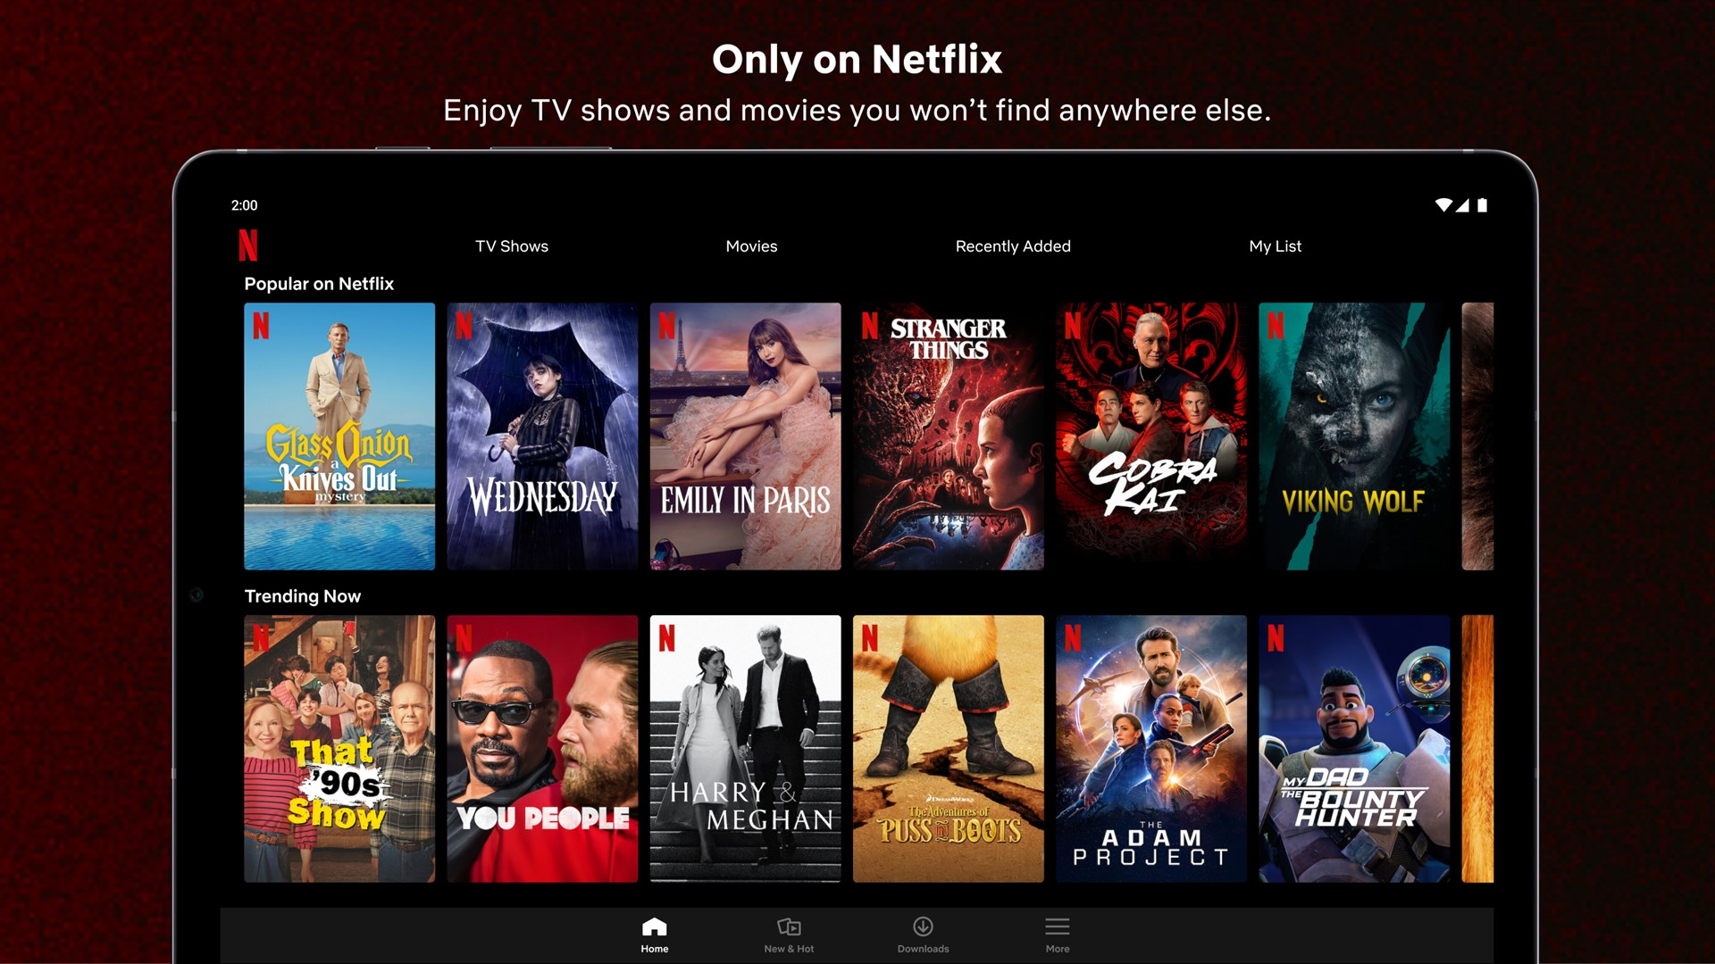
On Which Thumbnail do you click?

Slide 11
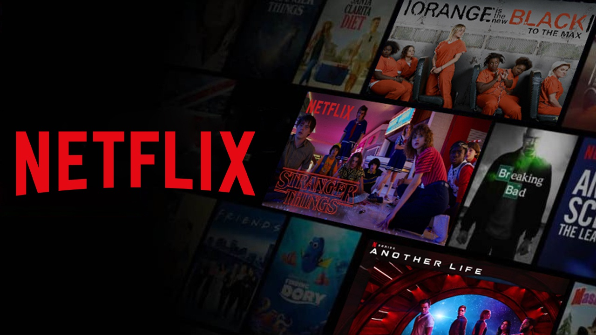
2.Auto GENERATED THUMBNAILS
Thumbnails can make a lot of difference in whether a user will watch a movie or not. Just imagine you are browsing through Netflix and you see a very interesting thumbnail for a movie or series you’ve never watched. You will definitely click on the thumbnail and check out that movie (whether you light it or not is a different matter!) So the images on the thumbnail can make a big difference for the traffic to a particular movie or series for Netflix.
That is why they have personalized auto-generated thumbnail images that are created according to the individual user’s tastes in movies. Netflix uses machine learning to analyze your movie and series choices and understand what sort of thumbnail you are most likely to click. For example, the series Riverdale can have two different thumbnails, a sweet romantic version or a serious mystery version and you will see the one depending on your tastes. While Riverdale has both these aspects, the thumbnail according to your preferences will push you in at least checking out these series, and then you can decide if you want to stick or not!

Slide 12

3. Streaming Quality
What the worst thing that can happen when you are watching a movie? It’s buffering of course! Buffering or low video quality takes you out of the movie totally and is very irritating. Netflix knows this, and they have tried their hardest to ensure that there is no buffering or loss of streaming quality when viewers are watching movies or shows. After all, those things can be killer and result in people switching to rival services like Amazon Prime or Hulu.
But how does Netflix ensure the best streaming quality so that there are no glitches even during peak times? It cannot be easy since they have around 200 million subscribers all over the world. Netflix uses machine learning algorithms to predict the viewer patterns and understand when there will be general increases and decreases in viewers of spikes in viewing a certain movie or show. Then they can cache the regional servers that are much closer to the viewers so that there is no log in streaming or loading times even during peak popularity periods

Slide 13
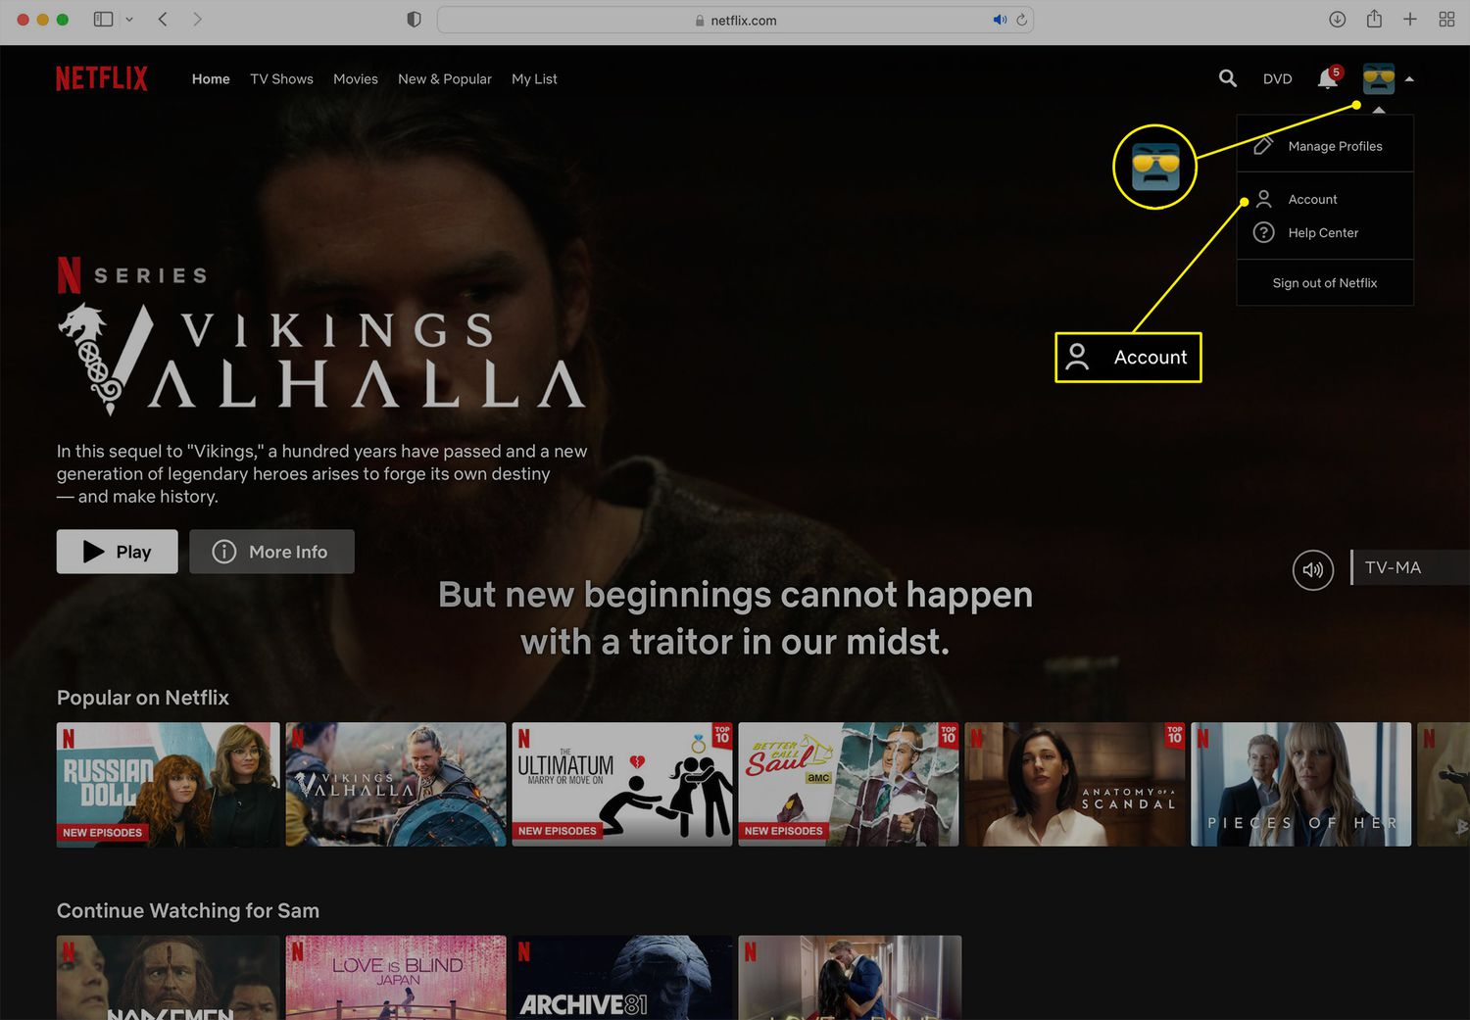

Slide 14
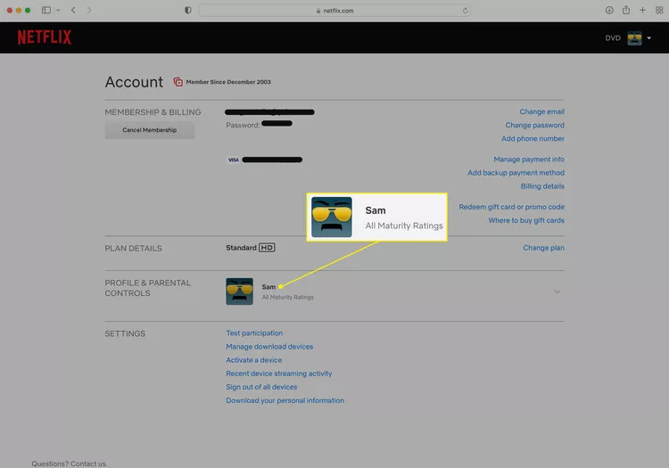

Slide 15
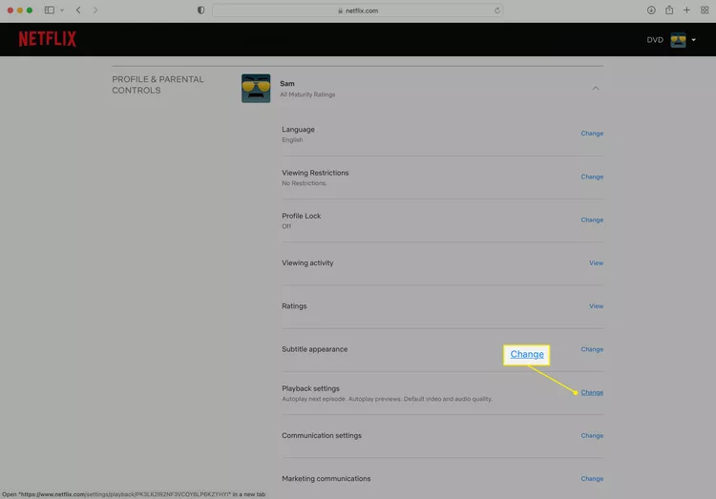

Slide 16
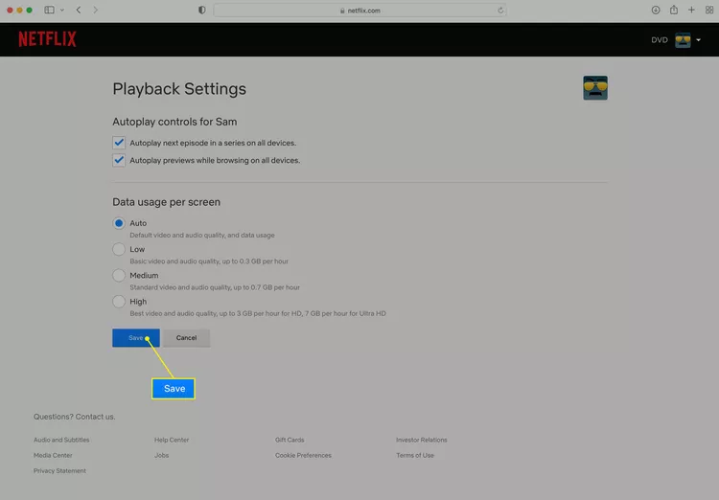

Slide 17

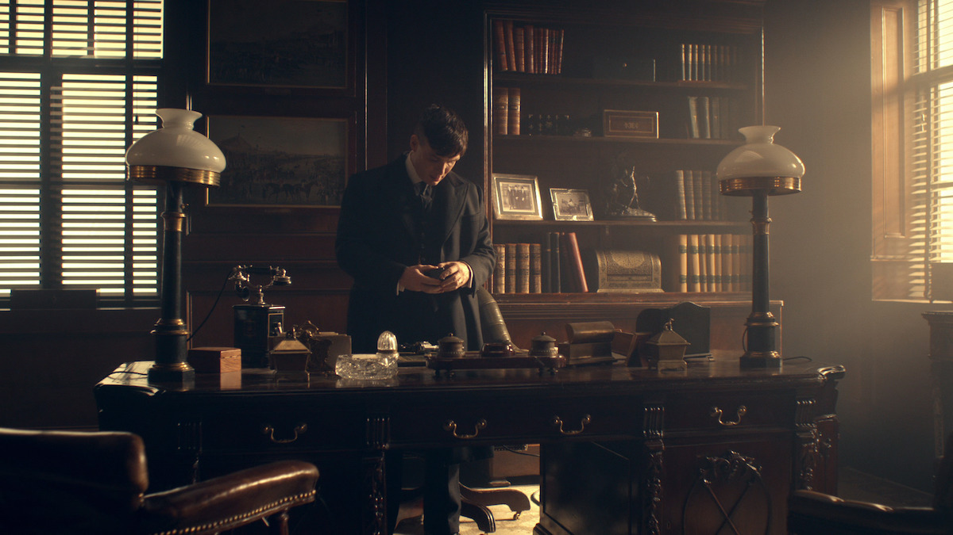
Black Country Living Museum (Dudley)
Port Sunlight Village (Wirral)

Slide 18

4. LOCATIONs FOR SHOOTING
Netflix is not just a streaming platform that showcases different movies and series. It is also a production company that creates and produces many fantastic movies and series! If you are interested, then check out Delhi Crime, Orange is the new Black, The Crown, Queen’s Gambit, etc. which are all Netflix originals (and pretty good)! Anyway, Netflix needs to decide on the locations of shooting all these movies and series.
There are many factors in choosing a particular location such as the cost and budget factors, scheduling conflicts for actors and crew, specific shooting requirements (like a desert, or coastal city, or night-time shooting), weather situation for a location, the possibility of gaining the permits from the local administration, etc. All these factors need to be considered by the production team before deciding on a location and machine learning can be a big help in this. A machine learning algorithm can be used to find a list of optimal locations in the world based on all the constraints that need to be satisfied.

Slide 19
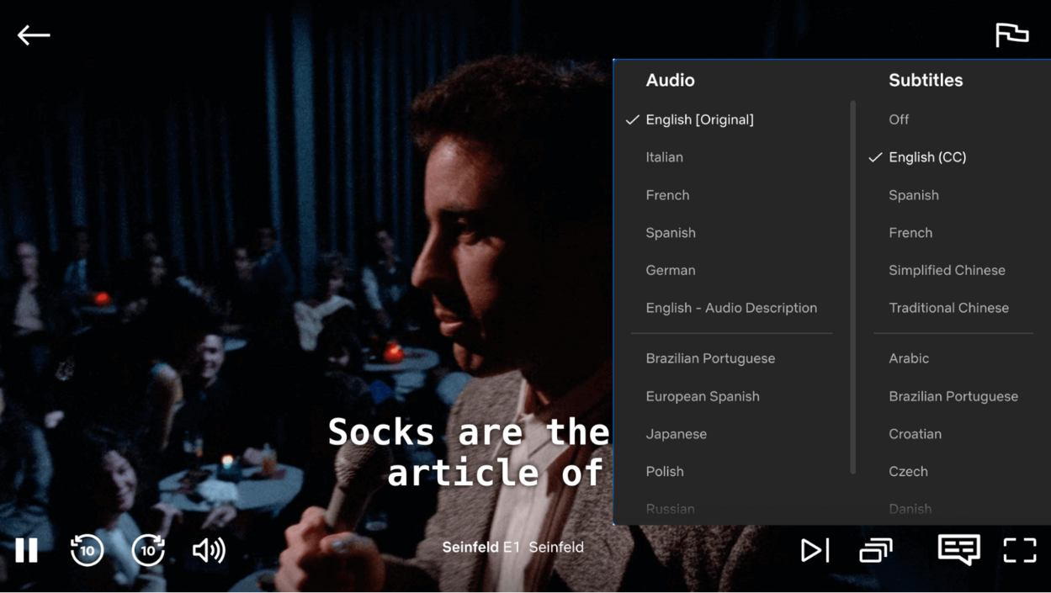

Slide 20
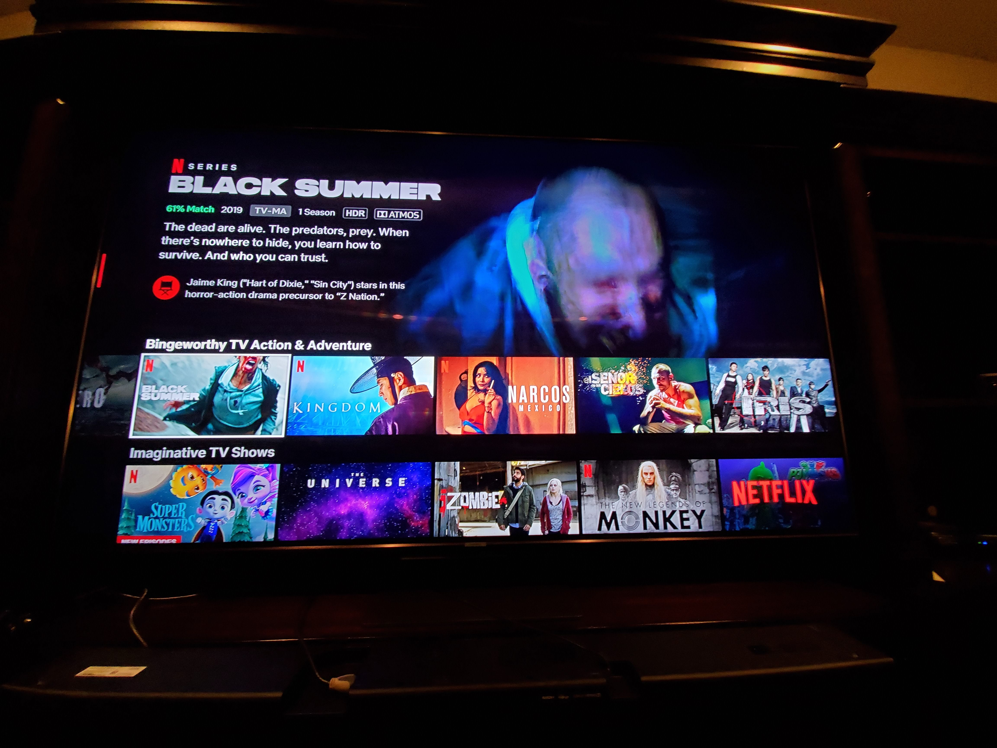
5. Content quality
Why is Netflix so popular? That’s because it’s not just a streaming platform but also an experience for all its users. The beautiful user interface, the personalized recommendations, the variety of subtitle options in each language, the creative original productions, all of these make Netflix what it is! Just think, would you be addicted to Netflix if their quality were not so good? No.
That’s why managing content quality is such an important part of Netflix. And they use Machine Learning for this as well! Netflix has created a supervised quality control algorithm that passes or fails the content such as audio, video, subtitle text, etc. based on the data it was trained on. If any content is failed, then it is further checked by manually quality control to ensure that only the best quality reached the users. After all, you probably wouldn’t watch Stranger Things on Netflix if the subtitles were wrong or the audio was lagging behind the video

Slide 21
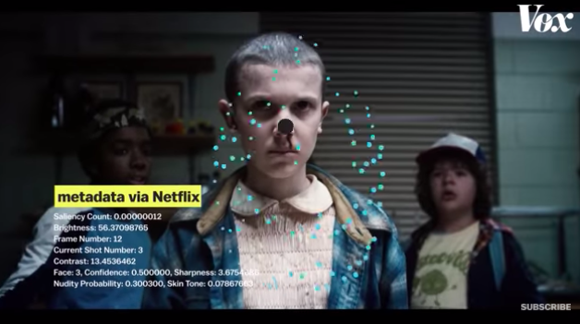
Some Other uSEs
Deploys Frame Annotation process-
In this process, each frame is tagged or labelled with metadata that indicates the key variables about the content piece. These variables include-
Saliency
Frame number
Brightness / Contrast
Nudity probability
Face/skin tone
The following characteristics are then used to grade the frames-
Visualisation (brightness, contrast, colour, motion blur)
Contextual (detection of faces / shot angle)
Composition (photography principles like “rule of thirds”, symmetry, depth of field, etc.)

Slide 22
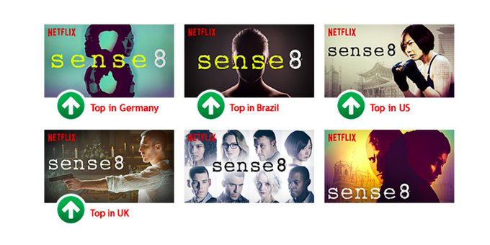
Some Other uSEs
Emphasis on localisation-
Regional differences still exist, according to Netflix, and are crucial for particular titles and graphics. While excellent stories transcend borders, they discovered that how each narrative is presented in different regions impacts how quickly users discover that piece through artwork. For example, the ideal thumbnails for the show “Sense8” featured the characteristics that were most appealing to that country.

Slide 23
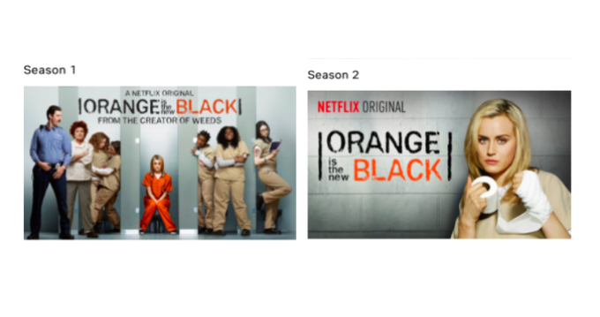
Some Other uSEs
Focus on the portrayal of the cast of the content-
Netflix discovered these facts when displaying the content’s cast and characters on thumbnails-
Villainous characters on thumbnails attract more viewership.
When there are more than three characters in a thumbnail, it significantly underperforms. For the premiere of “Orange Is The New Black,” Netflix used this knowledge.

Slide 24
Benefits OF AI IN

Slide 25
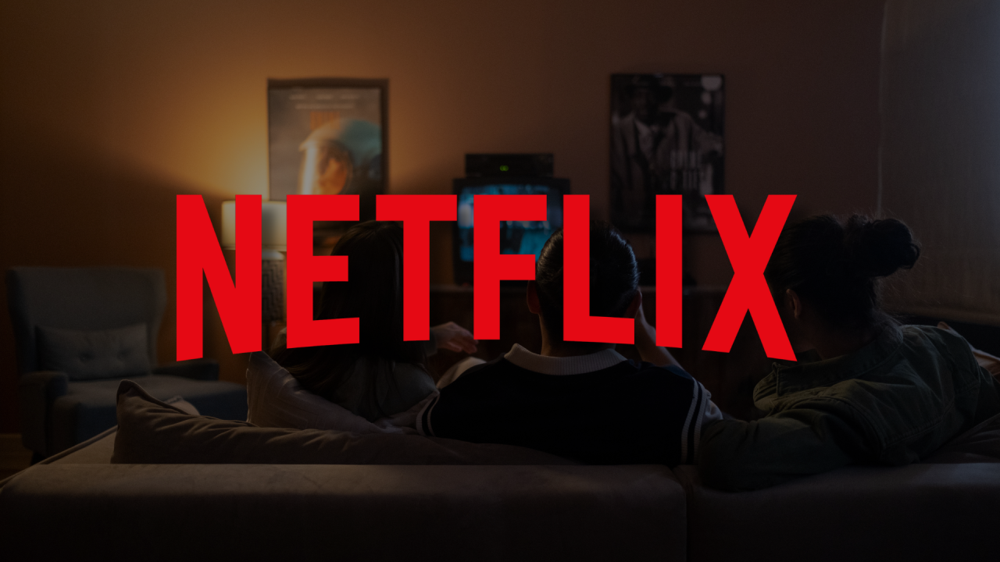
Helps users discover the next best show
There are tons of series out there, and it can be hard to identify which is worthwhile. The Netflix AI mechanism means you never have to worry about finding the next big show.
All you have to do is to follow the recommendations and sift through the other recommendation features. This reduces bounce rates drastically.

Slide 26
Cost-savings for Netflix
The Netflix OTT search engine is an excellent alternative to conventional digital marketing as it helps create awareness and boost users' interest in video content.
Netflix typically conducts data analytical research on viewed content and user patterns to promote certain shows. For instance, if your streaming activity revolves around fantasy and magical content, the Netflix machine learning algorithm displays similar popular content.
This is a promotional advantage for Netflix that saves them money on external advertising campaigns, especially for new content.
Instead of creating awareness about new shows the traditional way, they can recommend a show to those most likely to watch them — those at the bottom of the sales funnel, so to speak.

Slide 27
Optimizes ad campaigns for Netflix advertisers
In the previous section, we discussed how Netflix's data science models help the platform save ad costs. The same goes for its clients’ existing ad campaigns on the platform.
The platform lets advertisers optimize their campaigns via personalization. This allows for more efficient use of ad spending and consequently leads to higher conversion rates. Bear in mind that by doing this, Netflix also gets to protect its users’ interests. They don’t have to sit through totally irrelevant ads.
The bottom line is that Netflix offers advertisers a unique and powerful way of reaching and engaging with their target audiences via AI.

Slide 28
Future OF ML IN

Slide 29
The future of NETFLIX with AI and ML
Personalized advertising: AI and ML algorithms can help advertisers deliver more personalized and targeted ads, resulting in higher engagement rates and increased ROI.
Voice and gesture recognition: Voice and gesture recognition technology can enable users to control their viewing experience without the need for remote control, making the experience more intuitive and interactive.
Enhanced content creation: AI and ML can help content creators produce higher quality content more efficiently, through tasks such as noise reduction, frame interpolation, and color grading.
Virtual reality: AI and ML can be used to enhance virtual reality experiences, making them more realistic and immersive.
Overall, the future of OTT platforms with AI and ML is very exciting, and we can expect to see continued growth and innovation in this space.

Slide 30
REFERENCES
https://www.recosenselabs.com/blog/how-netflix-uses-ai-and-ml-to-determine-which-thumbnails-they-use
https://www.invisibly.com/learn-blog/netflix-recommendation-algorithm/
https://www.geeksforgeeks.org/how-does-netflix-use-machine-learning/
https://www.argoid.ai/blog/netflix-ai
https://experiencestack.co/the-roles-of-ai-and-ml-in-the-future-of-ott-platforms-fc9429e58114

Slide 31
